Slide 1
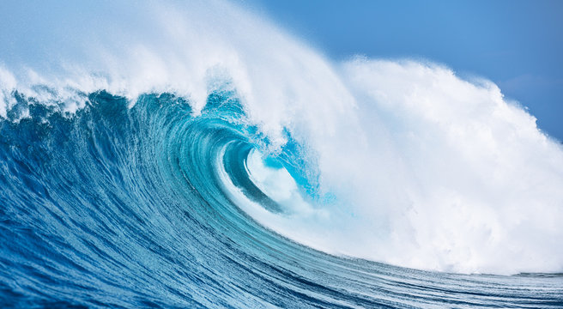
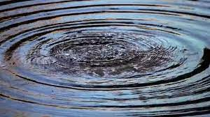
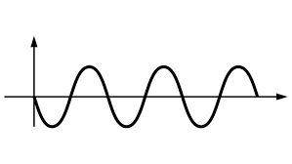
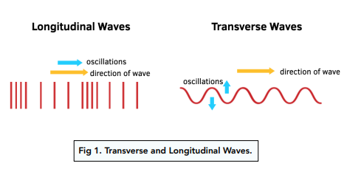
Waves & its Characteristics
BY :MASHHOOD ALI KHAN

Slide 2
INTRODUCTION TO WAVES
A wave is a mechanism by which energy is transferred from one place to another, without transporting medium.
OR
It is a travelling disturbance in any medium.

Slide 3
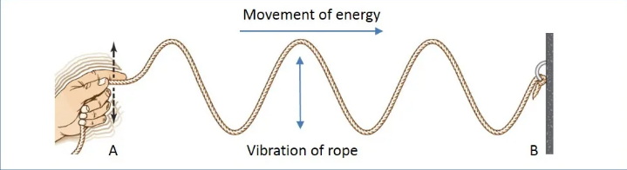
TYPES OF WAVES
Water waves
Waves on a string
1.MECHANICAL WAVES:
Those waves which require medium to propagate.
Cannot travel in vacuum.
Example: Sound waves, Water waves
Types of Mechanical waves :
1.Transverse Waves:
Waves in which vibration of particles of the medium is perpendicular to the direction of propagation of the wave.
Example: waves on a string

Slide 4
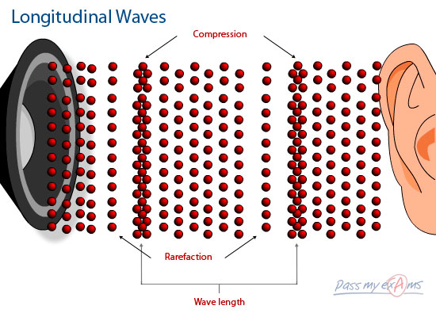
2.Longitudinal Waves
Waves in which vibration of particles of the medium is parallel to the direction of propagation of the wave.
Example: Sound waves in air

Slide 5
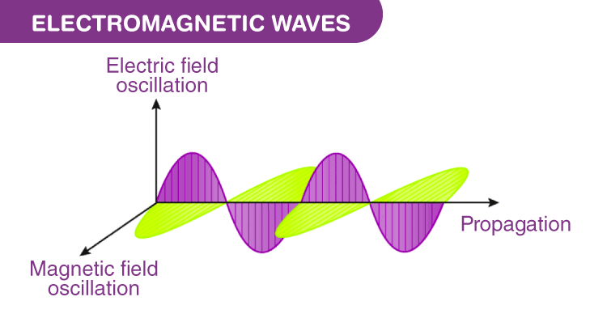
2.Electromanetic Waves:
Waves that do not require a medium to travel.
Can propagate in vacuum.
Formed by oscillations of electric & magnetic fields perpendicular to each other and to wave direction.
Examples:
Light
Radio waves
Microwaves
X-rays

Slide 6
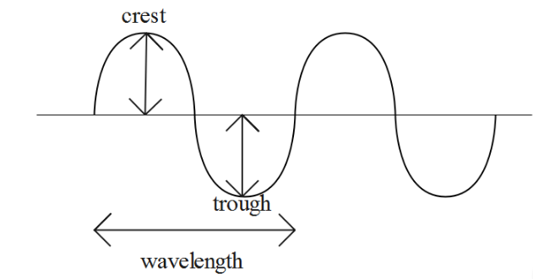
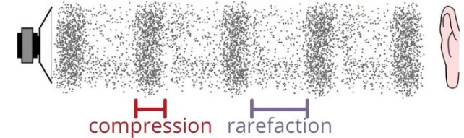
Characteristics of Waves
1.Crest & Trough (Transverse Waves)
Crest – Highest point of wave.
Trough – Lowest point of wave.
2.Compression & Rarefaction (Longitudinal Waves)
Compression – Region where particles are close together (high pressure).
Rarefaction – Region where particles are far apart (low pressure).

Slide 7
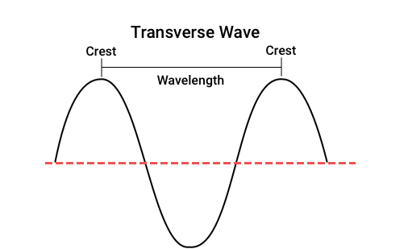
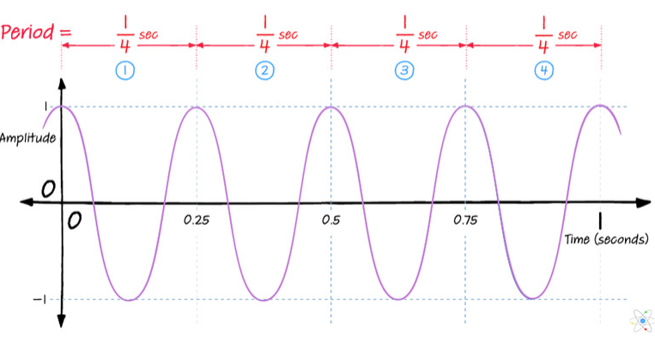
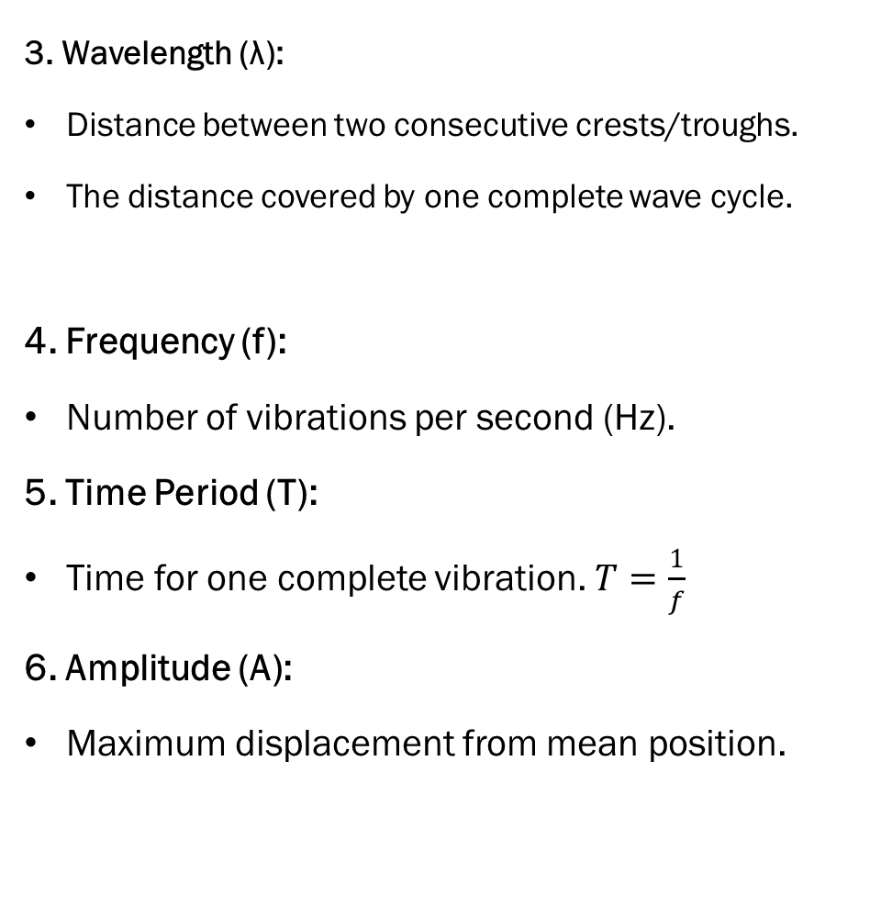
3. Wavelength (λ):
Distance between two consecutive crests/troughs.
The distance covered by one complete wave cycle.
4. Frequency (f):
Number of vibrations per second (Hz).
5. Time Period (T):
Time for one complete vibration. $T=\frac{1}{f}$
6. Amplitude (A):
Maximum displacement from mean position.

Slide 8
Thank you

